Slide 1
OS SCHEDULING USING MPI
GROUP MEMBERS
Hitesh Sethiya
Abhijeet Joshi
Krutika Nikumbh
Pratik Joshi

Slide 2
WHAT IS OS SCHEDULING?
OS Scheduling : The brain deciding which task the CPU should work on right now.
Short-Term Scheduler (a.k.a CPU Scheduler):
Picks from ready processes.
Runs every few milliseconds.
Main Goal:
Maximize CPU usage
Minimize waiting time.
🎯 Fun Example: Think of a pizza chef choosing which pizza to bake first from multiple pending orders.

Slide 3


Slide 4
WHAT IS MPI?
MPI stand for the Message Passing Interface.
MPI = A protocol for processes to talk and work together across systems. Built for distributed computing and parallel systems.
Handles:
Sending messages
Receiving messages
Synchronizing tasks
🚀 Analogy:
Employees sending WhatsApp messages to a team manager to update task status — quick and organize

Slide 5
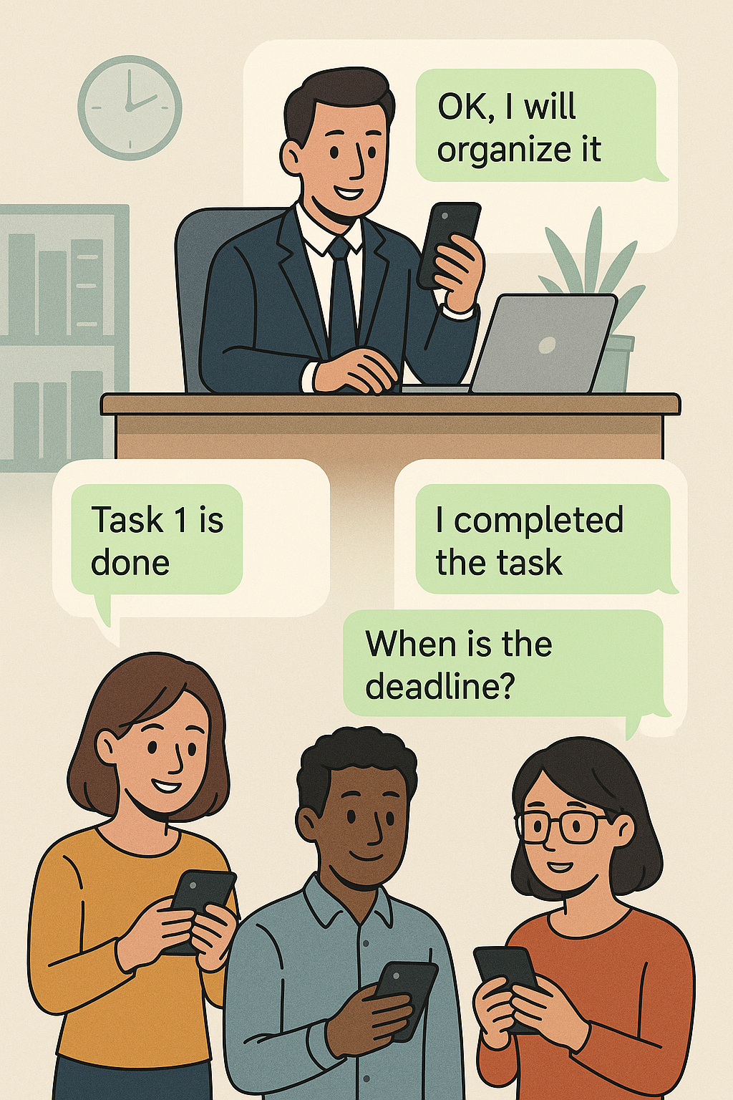

Slide 6
WHY USE MPI IN SCHEDULING?
Real-Time Communication: Processes update the scheduler instantly.
Efficient Resource Management: Handle 10, 100, or 1000 tasks easily!
Fault Tolerance: If one process fails, others continue via messages.
Distributed Power: Scheduling not stuck to one CPU — can be across systems!
💡 MPI makes a traditional OS scheduler ready for the modern multi-core, multi-machine world!

Slide 7
RELATIONSHIP BETWEEN MPI AND SCEDULER
Without MPI: One CPU, one queue, simple.
With MPI:
Processes from different nodes send messages.
Scheduler collects updates (arrival time, burst time, quantum status).
Dispatcher assigns CPU time fairly.
🎯 Visual: Processes = Students. Scheduler = Teacher collecting homework via emails (MPI) and deciding who presents first.

Slide 8
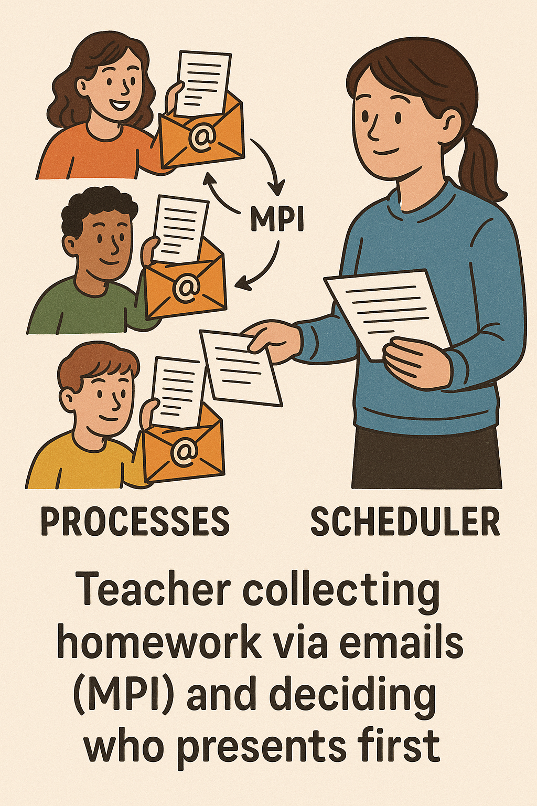

Slide 9
FCFS SCHEDULING ALGORITHM
First Come, First Serve (FCFS):
Jobs are executed in order of arrival.
No interruptions once a process starts.
Advantages:
Easy to implement.
Fair if processes are of similar size.
Disadvantages:
Long jobs delay everything (convoy effect).
🛒 Real-life Example: Supermarket checkout: first customer in line is served first — even if they have a full cart!

Slide 10


Slide 11
ROUND-ROBIN SCHEDULING ALGORITHM
Round Robin (RR):
Each process gets a fixed CPU time slot (quantum).
If it’s not finished, it goes to the end of the queue.
Advantages:
Great for interactive systems (low waiting time).
Prevents starvation of any task.
Disadvantages:
Too short quantum = lots of switching overhead.
Too long quantum = behaves like FCFS.
🎲 Real-life Example: Board games where every player takes turns rolling the dice — fair and equal opportunity.

Slide 12


Slide 13
HOW MPI HELPS IN FCFS AND ROUND ROBIN.
FCFS with MPI:
Each process sends arrival time.
Scheduler orders them correctly, even across machines.
RR with MPI:
After every quantum, a status message is sent.
Scheduler keeps rotating tasks in a global ready queue.
🛠 Key Point: Without MPI = Only local scheduling. With MPI = Global scheduling across clusters or cores!

Slide 14
PROJECT HIGHLIGHTS
Designed a Scheduler using MPI message passing.
Implemented:
FCFS for simple, fair execution.
Round Robin for interactive, responsive scheduling.
Tested with multiple nodes (simulated tasks).
✨ Learning Outcomes:
Hands-on understanding of scheduling strategies.
Parallel communication with real MPI programs.

Slide 15
CONCLUSION
Conclusion:
Short-term scheduling ensures fast and fair CPU use.
MPI allows scaling this scheduling beyond one CPU, across nodes, for faster performance.
Future Scope:
Add Priority Scheduling (High-priority tasks go first).
Simulate real cloud OS environments (AWS, Azure) with MPI.

